Slide 1
Polydojo Hackathon
Integrating personalized Email

Slide 2
Problem to tackle:
Currently, the students have to suffer from a long queue only to receive one concession form.
The concession admin verifies the details of each person in the queue with his/her previous pass details.
This results in longer wait times.

Slide 3
Demo

Slide 4
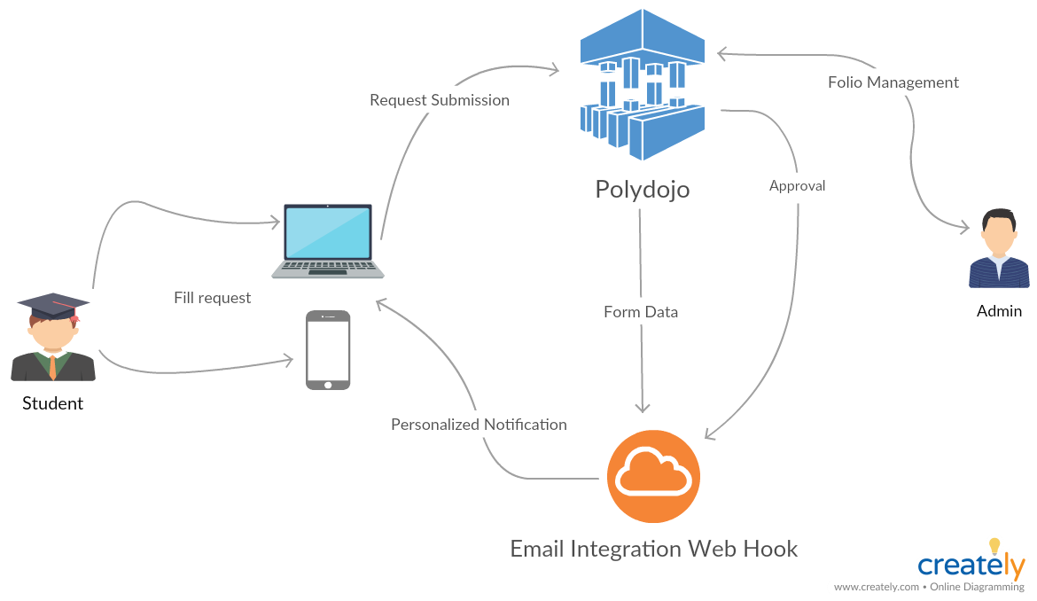
Behind the scenes

Slide 5
Thank You

